Slide 1
UML Unified Modeling Language
By: Bronze Beard and the swamp donkeys
(Robert nielsen, cody lundberg, sawyer gehring, andrew lundgren, nakai velasquez, trevik peterson, zach newell)

Slide 2
Overview
UML is a method of modelling parts a system and how they relate to each other. There are four important aspects of UML:
Classes: Individual parts of the system and how they function.
Components: Each part of the system individually.
Composition: How the components are organized.
Communication: How the components are related.

Slide 3
Class
Class Name​
+public_Variable : type​ #protected_Variable : type​ -private_Variable : type​
-private_Method()​ #protected_Method()​ +public_Method()​
Other Class Information​
A Class is a 3-part entity containing a name, the entity’s attributes, and its operations
Class Name
Class Attributes, type is shown after colon
Class Operations
[5]
Symbols before an attribute or operation denote item visibility:
‘+’ public
‘-’ private
‘#’ protected
[5]
Notes:
Class Name
The name of the class appears in the first partition.
Class Attributes
Attributes are shown in the second partition.
The attribute type is shown after the colon.
Attributes map onto member variables (data members) in code.
Class Operations (Methods)
Operations are shown in the third partition. They are services the class provides.
The return type of a method is shown after the colon at the end of the method signature.
The return type of method parameters are shown after the colon following the parameter name.
Operations map onto class methods in code [5]

Slide 4

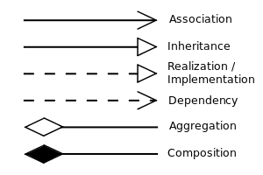
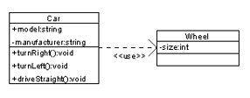
Class
Class relationships are denoted by the connection between them
Notes:
Associated with
Inherits from (is a)
Implements
Dependent on
A part of (has a)
A part of that is

Slide 5
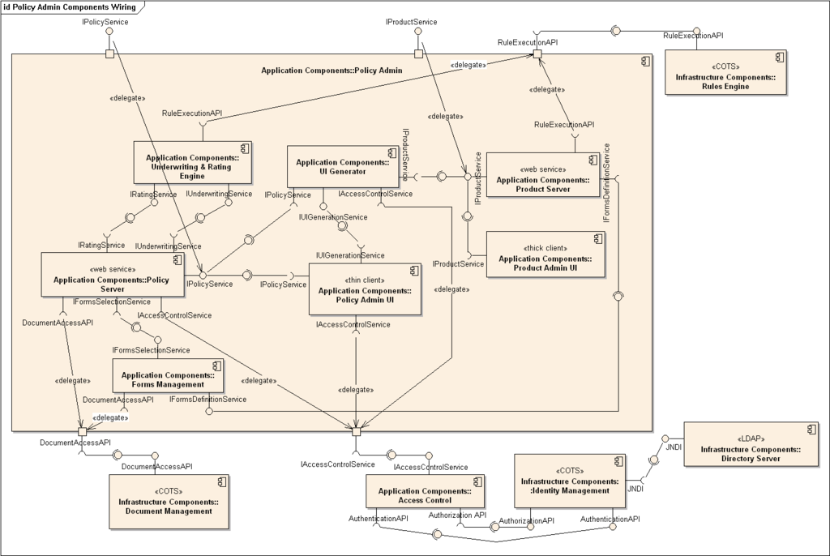
Component - Overview
A modular part of the system
Abstract
Helps one see the big picture
Shows actual organization of software
Keeps everyone on the same page
Component Diagram [Component Image]

Slide 6
Component – Cont.
Benefits
Great way to view large software system and how they are wired together.
Has a "higher level of abstraction than a Class Diagram." [6]
Can build logical structures with private data transparency. [6]
Cautions
Whole components can become inconsistent when changes are made. [1]
Components require solid understanding of complex systems to find design inconsistencies. [1]

Slide 7
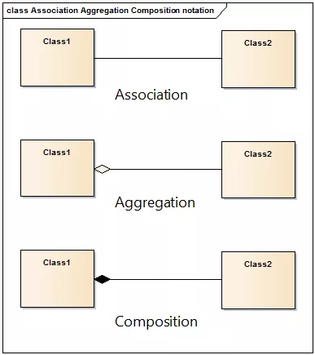
Aggregation and Composition
A concrete definition of how separate objects and data types are associated with each other.
As – Any line on a UML diagram
Ag – Course with students
Co – Course with assignments

Slide 8
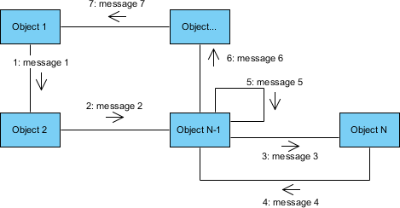
Communication
A diagram showing how all of the
components are related
The first message in a communication diagram is always numbered 1, the second is 2, and so on.
You can indicate that a message is nested under a parent message by adding a decimal point and incremental digits to the parent's sequence number.
There are arrows indication the direction of the flow of communication.

Slide 9
Works Cited
[1] A. Egyed, "Fixing Inconsistencies in UML Design Models," 29th International Conference on Software Engineering (ICSE'07), Minneapolis, MN, 2007, pp. 292-301. https://ieeexplore.ieee.org/document/4222591
[2] Andrews, France, Ghosh, Craig, "Test adequacy criteria for UML design models," First published: 25 June 2003, Online at: https://doi.org/10.1002/stvr.270
[3] People Career, "6 5 Using aggregation and composition," YouTube: 22 May 2015, online at: https://www.youtube.com/watch?v=d5ecYmyFZW0
[4] Visual Paradigm, "UML Association vs Aggregation vs Composition," Visual Paradigm: Publication date unknown, online at: https://www.visual-paradigm.com/guide/uml-unified-modeling-language/uml-aggregation-vs-composition/

Slide 10
Works Cited
[5] Visual Paradigm, "What is Class Diagram?," Visual Paradigm: Publication date unknown, online at: https://www.visual-paradigm.com/guide/uml-unified-modeling-language/what-is-class-diagram/
[6] Sparx Systems, "UML 2 Tutorial – Component Diagram," Published by Sparx Systems. Online at: https://sparxsystems.com/resources/tutorials/uml2/component-diagram.html
[7] Visual Paradigm, “What is Communication Diagram?” Visual Paradigm: Published by Visual Paradigm, online at: https://www.visual-paradigm.com/guide/uml-unified-modeling-language/what-is-communication-diagram/;WWWSESSIONID=7F8A61CEB3485E26C68E09A711CE0B3A.www1

Slide 11
Works Cited Cont.
[8]: Feinerer, Ingo "A Formal Treatment of UML Class Diagrams as an Efficient Method for Configuration Management" Theory and Logic Group Institute of Computer Languages Vienna University of Technology, Vienna, March 2007
[9] Larman, C. (2002). ”Applying UML and patterns : an introduction to object-oriented analysis and design and the unified process.” Prentice Hall PTR. Online at: https://search.ebscohost.com/login.aspx?direct=true&db=cat03146a&AN=BYUID.361436&site=eds-live

